Slide 1
Enterprise Apps & Agents
POWER PLATFORM
Enterprise Code App → Dataverse → AI Builder → Copilot Studio Agent → Governed Automation → Capstone Project

Slide 2
AI Builder
POWER PLATFORM · TRAINING
Add AI to your apps, flows and agents without writing code
Notes:
Welcome. This session is built for makers who are new to AI Builder: about 60 to 90 minutes with two short hands-on labs. Replace the presenter name and date on this slide. Assumed audience: Power Apps and Power Automate makers and business analysts. Licensing details change often, so confirm the credits slide against Microsoft’s current licensing guide before you present.

Slide 3
Microsoft AI for makers, with no data science required
WHAT IS AI BUILDER
AI Builder is a Power Platform capability that gives your apps, flows and agents access to Microsoft AI, including GPT and document intelligence models.
Prebuilt models
Custom models
Prompts
Notes:
Key message: makers get Azure AI capabilities through the same low-code surfaces they already use. The three pills are the three building blocks we will return to: prebuilt models, custom models, and prompts built on large language models.

Slide 4



One capability, three places to use it
WHERE IT FITS
Power Apps
Power Automate
Copilot Studio
Add AI components to screens, such as document and business card readers, or call prompts from your app.
Add AI Builder actions to flows to extract, classify or generate content, then act on the result.
Use prompts as tools inside agents and agent flows.
Notes:
The same models and prompts can be reused across all three. Makers manage them from the AI hub in the Power Apps or Power Automate maker portals.

Slide 5
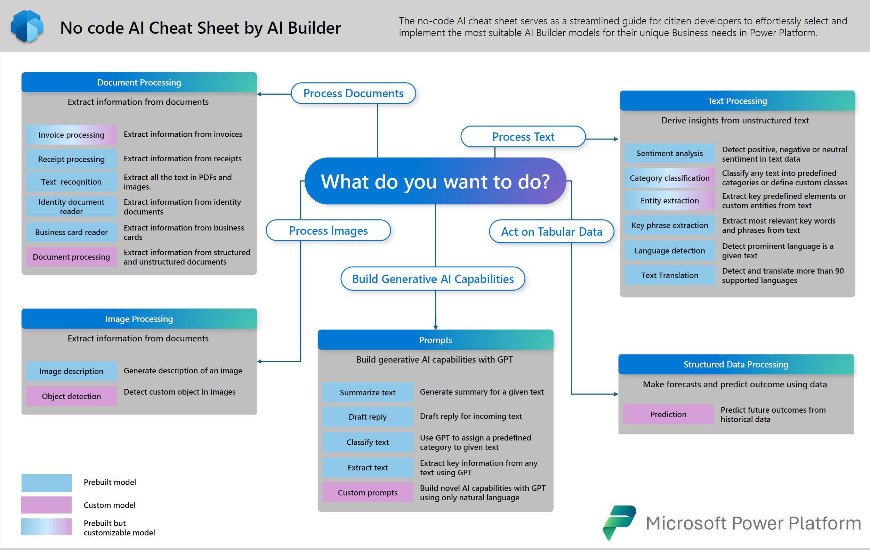

Slide 6
What AI Builder can do
CAPABILITIES
Capability | What it does | Examples
Document processing | Extracts fields from documents | Invoices, receipts, IDs, business cards, contracts
Text processing | Analyzes and classifies text | Sentiment, language detection, key phrases, entities, translation
Image processing | Reads and detects in images | Text recognition, custom object detection
Prompts | Generative AI from plain instructions | Summaries, extraction, drafting, classification
Notes:
Walk the rows top to bottom. Document and text processing are the most common starting points for business scenarios. Prompts are the newest addition and are where Microsoft is concentrating its investment.

Slide 7
Prebuilt or custom models
MODELS
Prebuilt
Custom
Ready to use, no training
Trained on your own data
Invoice, receipt, ID and business card processing, sentiment analysis, language detection, entity extraction and translation.
Prediction, document processing, category classification, entity extraction and object detection for your business scenarios.
Rule of thumb: start with a prebuilt model, and train a custom one only when it falls short.
Notes:
Custom models need labelled training data and time to train and test, so they cost more effort. Testing prebuilt or custom models in the maker portals does not consume credits.

Slide 8
From document to data in a flow
DOCUMENT PROCESSING
Trigger the flow when a file arrives in SharePoint, OneDrive or email
Add an AI Builder action
Choose the action that matches the document type
Use the extracted fields in later steps
Ready-made actions
Invoices
Receipts
Identity documents
Business cards
Text in images and PDFs
Notes:
Documents can be structured, like invoices, or unstructured, like resumes. Automating extraction speeds up tedious manual work and reduces errors. Demo idea: drop a sample invoice into a SharePoint library and show the extracted fields in the flow run history.

Slide 9
Build a reusable prompt in four steps
PROMPT BUILDER
1
2
3
4
Open it
Write it
Add inputs
Test and reuse
AI hub, then Prompts, then Build your own prompt.
Name the prompt, then write instructions or start from a template.
Use input variables for content that changes at runtime.
Validate the output, then use it in apps, flows and agents.
Notes:
A prompt is a natural-language instruction that tells a large language model what to do. Prompts are solution-aware, so they can be moved between environments with your other components. In Copilot Studio you can also add a prompt as a tool inside an agent. Menu names may shift slightly between releases.

Slide 10
Models or prompts?
CHOOSING
 | Prebuilt and custom models | Prompts
Setup | Use prebuilt as is, or train on your data | Write plain-language instructions, no training
Best for | Production work that needs accuracy and repeatability, such as invoices | Flexible tasks such as extraction, summaries and drafting
Watch for | Training data and effort for custom models | Variable output, so add examples and validate
Notes:
Prompts are cheaper and faster to start with, but output can vary and may need validation or post-processing. Models are the safer choice for repeatable, accuracy-critical production scenarios. The platform is shifting toward prompts, and prebuilt document models are also available as editable prompt templates.

Slide 11

Invoice to approval, end to end
EXAMPLE
1
2
3
5
Invoice arrives
4
Extract
Check
Approve
Record
Email or SharePoint
AI Builder reads the fields
A prompt flags odd items
A person decides
Save to your system
Notes:
This is the pattern most teams start with: trigger, extract, validate, approve, record. Step 3 is optional and shows how models and prompts can be combined. Keep a human at step 4 for anything with financial impact.

Slide 12
AI Builder now runs on Copilot Credits
LICENSING
AI Builder credits are being phased out, with full transition by 1 November 2026. There is no automatic conversion to Copilot Credits.
Apps and flows
Agents and agent flows
Use AI Builder credits first, then Copilot Credits.
Use Copilot Credits only.
Out of credits
Monthly reset
Model runs are blocked until you add or reassign capacity.
Unused credits do not roll over. Testing models does not consume credits.
Notes:
Source: Microsoft Learn licensing pages and the Microsoft 365 message center notices on the end of AI Builder capacity packs. Existing AI Builder credits remain until they expire. Credit rates per action are in the Power Platform Licensing Guide; check it for current numbers before presenting, as rates and plans change. Admins can allow or block drawing on Copilot Credit capacity per environment in the Power Platform admin center.

Slide 13
Using AI responsibly
GOVERNANCE
Keep a human in the loop
Test with varied inputs
Review outputs regularly, especially where decisions have real impact.
Try typical, messy and unusual cases before you share a prompt or model.
Admin controls
Prerequisites
Allocate capacity per environment and control which AI capabilities makers can use.
A supported region, a Dataverse database in the environment and a Power Apps or Power Automate license.
Notes:
Makers remain responsible for making sure their prompts and models follow responsible AI practices and internal governance standards. If a model generates content that is not relevant to the use case, adjust the prompt. Check the current list of available regions on Microsoft Learn.

Slide 14
Pull action items out of an email
HANDS-ON LAB 1
Open AI hub, then Prompts, then Build your own prompt
Name the prompt and write the instruction
Add an input variable for the email text
Test with three different emails and refine the wording
Save the prompt so you can call it from a flow
Notes:
Give participants three sample emails of different lengths, one of them with no action items, so they see how the prompt behaves on edge cases. Encourage them to add an example of the desired output format to the prompt and compare results. Time estimate is a suggestion; adjust it for your group.

Slide 15

Demo
POWER PLATFORM
H1. Insurance: extract structured claims-document data
H2. Banking: build and test transaction-summary prompts
H3. Healthcare: implement a confidence-gated triage suggestion
Notes:
Welcome. This deck walks through what you need before building your first Power Apps Code App, then the six commands that take you from a starter template to a deployed app.

Slide 16
Closing slide
Thank you

